Slide 1


Sprint 7
The Two Stooges
Levi Graham
Riley Nichols

Slide 2
Recap on Project
The goal of our project is to build and demonstrate a haptic glove as meaningful input into a computer.
At the end of last semester, we had a working prototype of the hardware and a short demonstration of the start of the Unity Project.

Slide 3
Sprint 7 Plans
Going into Sprint 7, we wanted to refresh ourselves after our 1 month hiatus from the project.
Get in Multiplexer, Bluetooth Module and Soldering Station
Get Bluetooth Module Set up and start working with Multiplexer

Slide 4
Multiplexers
With the unexpected snow day, waiting on parts and not being able to work outside normal class hours, our progress was limited.
Research into multiplexers show that the way they operate is perfect for our purposes.
Using multiple inputs, it will read each one in succession and relay the information quickly to the Arduino with a special identity to help show which input is being read.

Slide 5
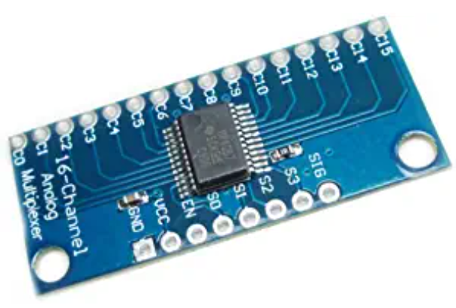
Our Multiplexer
This is the HiLetgo CD74HC4067 CMOS Multiplexer Breakout Module. It allows up to 16 analog inputs to be made and read by a single port on the Arduino.
We plan to use this primarily to simplify the finger circuitry and allow us to use all fingers with only a slight delay.

Slide 6

Bluetooth (HC-06)
They HC-05 was able to send serial data at a 9600 baud rate. There are some momentary issues with switching it to our 115200 baud rate, but the HC-06 device is capable of switching over, up to 921600bps.
The HC-06 is also capable of connecting to any Bluetooth system and can be read as a simple COM Port to receive data.

Slide 7
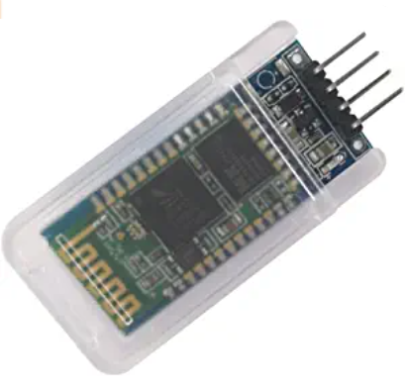
HC-06 Module
This is the DSD TECH HC-06 Bluetooth 2.0 SPP module for Arduino. It can act as a master or slave device; however, it should only be needed as a master device, intended to send serial data over to a computer system to be interpreted.
This Module can increase its baud rate, well past what the HC-05 was capable of, and past what we currently need it to read on our project.

Slide 8
Unity – Starting Implementing Physics
When I demonstrated the Demo last time, all that was set up was the scene and got looking around.
This time I have physics working.
The player can move around and interact with the balls, haven't been able to finish them picking up the ball and throwing it.
Need to figure out how to emulate the glove with traditional keyboard and mouse inputs for throwing interaction.

Slide 9
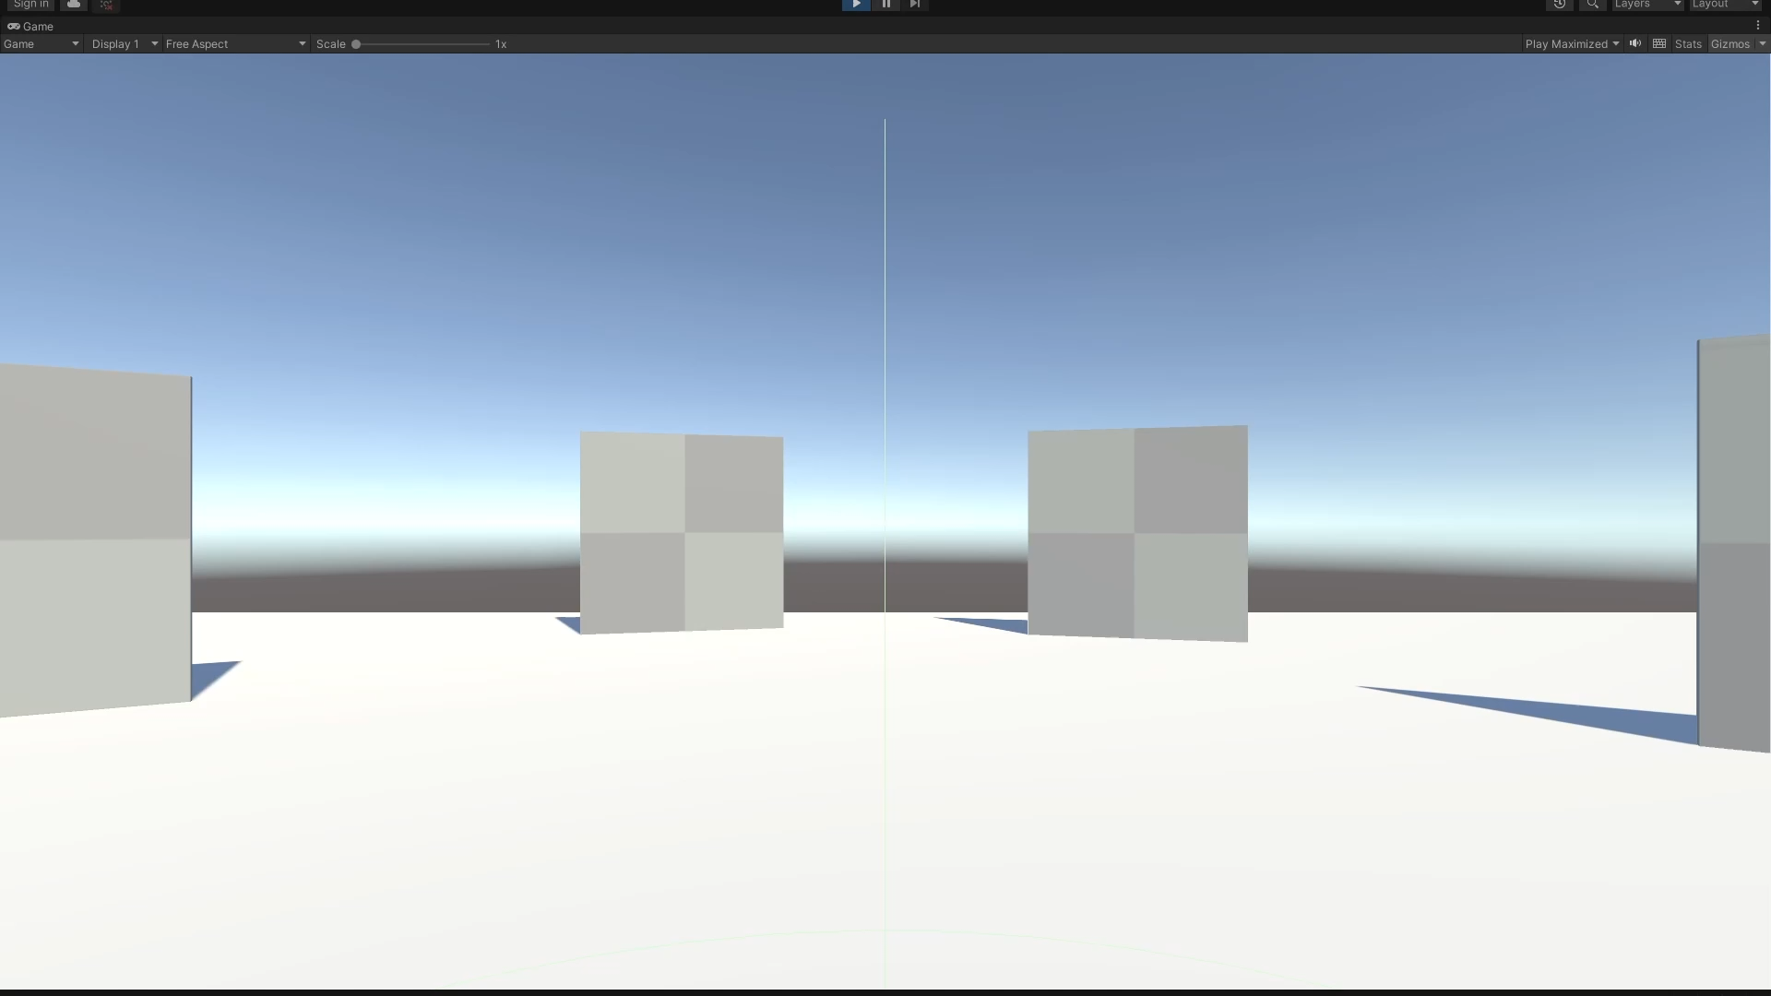
Unity - Demo

Slide 10
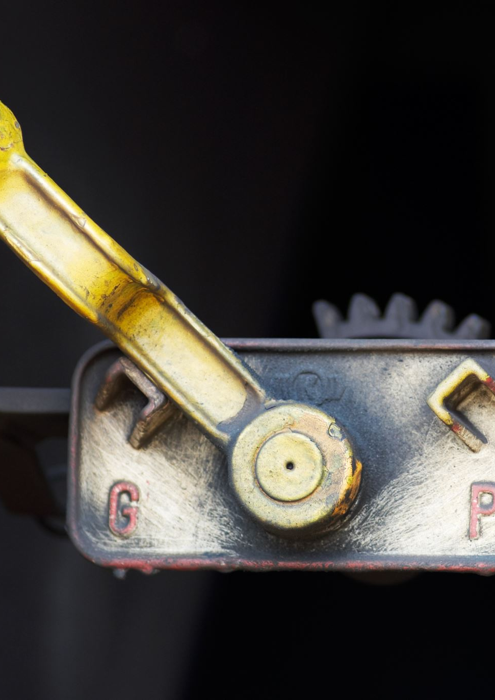
Plans for Sprint 8
We want to integrate the HC-06 and multiplexer modules into our circuit.
We also want to start design of how the circuit will be worn as a glove.
We want to start permanent build of the circuit by starting to solder what we finalize on the breadboard together.

